Slide 1
IBM University Engagement Project Submission
“Exploring the Power of Agentic AI with IBM Granite and IBM Bob”

Slide 2

Project Tile – [Research Agent]
Domain of Project – [Education]
Student Name | Recent Passport Photo | Email ID | Mobile number [WhatsApp]
Mr. Shobhit Prajapati |  | shobhit.Prajapati.14@gmail.com | 9927720699
Recommended font style and size: Font Style: Arial Font Size (Heading): 28
Font Size (Content): 20

Slide 3
Problem Statement -
Problem Statement : Research Agent
The Challenge
Researchers, students, and professionals often deal with scattered academic papers, technical articles, and experimental data spread across multiple platforms. Filtering relevant knowledge, summarizing insights, and keeping track of the latest developments is time-consuming and inefficient. The challenge is not just to collect references but to synthesize, analyze, and generate actionable research insights in real time.
The Objective
Build an agentic AI application that acts as an intelligent research companion. The solution should:
Fuse Academic Sources: Aggregate data from research papers, journals, preprints, and knowledge repositories, then synthesize them into clear, concise literature reviews.
Enable Multimodal Research Input: Accept user queries, notes, charts, or even PDFs, and convert them into structured insights, references, and summaries.
Create a Predictive & Agentic Layer: Highlight emerging trends, detect citation gaps, and predict promising directions for future research in a given domain.
Visualize Research Insights: Provide an interactive dashboard with topic clusters, citation maps, sentiment/trend analysis, and concise knowledge graphs.

Slide 4
Proposed Solution -
Proposed Solution: AI-Powered Research Agent
The proposed solution is a multi-agent, AI-powered Research Agent built using IBM Bob, IBM watsonx.ai, and Granite Models to provide personalized, real-time academic and market intelligence. The system addresses deep-seated challenges in literature review, data synthesis, and trend forecasting through an intelligent, modular architecture.
The system consists of four key agents:
Literature Synthesis Agent: Retrieves, filters, and summarizes dense academic or market information using the RAG pipeline to eliminate manual sourcing fatigue.
Methodology & Outline Agent: Generates tailored research frameworks, study designs, or report outlines based on user inputs such as research domain, scope constraints, and core objectives.
Critical Analysis & Trend Agent: Provides deep analytical insights, identifying research gaps, cross-domain correlations, and predictive industry trends within the ingested literature.
Source Ingestion & Citation Agent: Allows researchers to upload raw reference materials via text, documents, or audio notes, delivering instant structural analysis and automated, compliant citation feedback.

Slide 5
Technology Used
IBM Bob platform -For designing and orchestrating multi-agent workflows visually
IBM Grainte model - for eg – ibm-granite-3-2-8b – For natural language understanding, reasoning, and personalization
IBM Cloud – It provides the infrastructure to build, deploy, and scale the Nutrition Agent efficiently. IBM Cloud enables a reliable, secure, and scalable environment for deploying the Nutrition Agent.
RAG– RAG to fetch real data first, then generate intelligent answers, making the Nutrition Agent more trustworthy and effective.
IBM Watsonx.ai - For model deployment, embeddings, and AI governance
Vector Database (FAISS/Chroma) – For RAG-based nutritional data retrieval

Slide 6
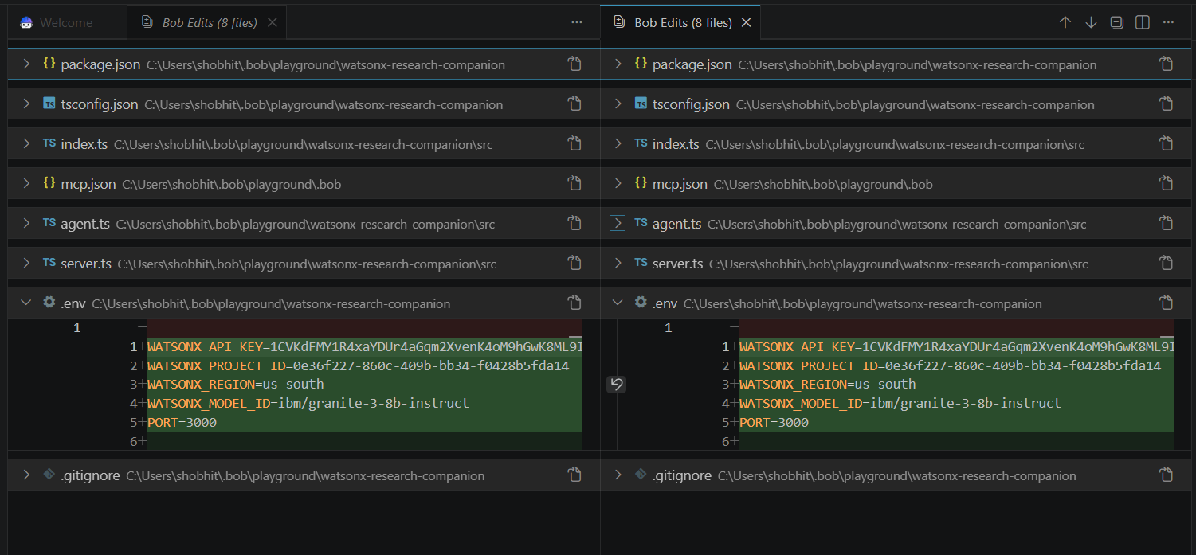
Required Files created using IBM bob -
App.py
Requirements.txt
Style.css
.env
Index.html

Slide 7
IBM Bob Screenshots:

Slide 8
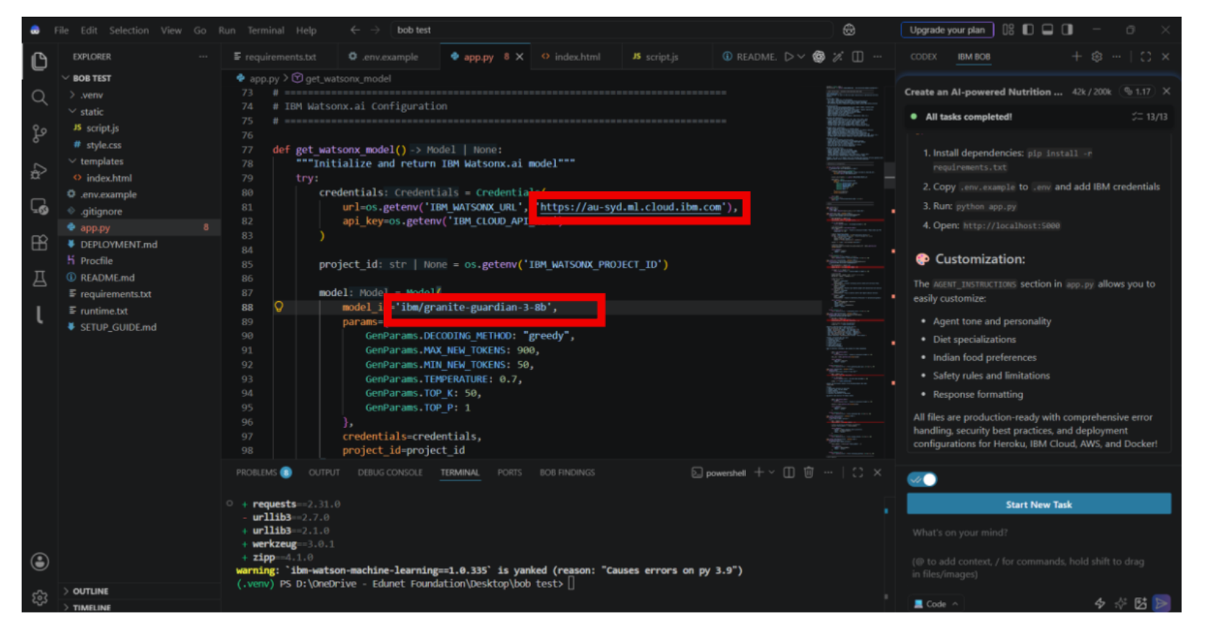

Slide 9
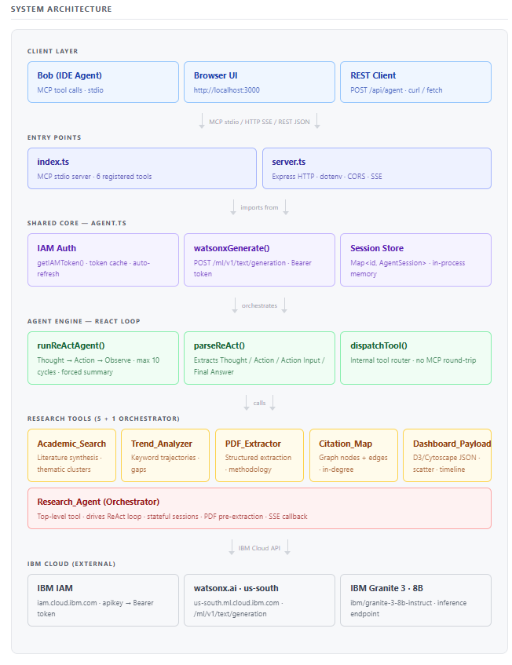
Architecture blueprint for IBM bob:

Slide 10

Role of Agentic AI in the solution
Role of Agentic AI in Research Agent
Agentic AI acts as an autonomous orchestrator that transforms your application from a static search filter into a living, reasoning research companion. For Academic Fusion, the AI functions as a decomposition engine, breaking down complex research requests, delegating tasks to dedicated scraping tools, and actively resolving source contradictions through automated debate loops. For Multimodal Input, it serves as a dynamic interpreter that selects the right specialized tool—like a vision model for charts or a python script for data to map user uploads into unified text insights. In the Predictive Layer, the agent's proactive autonomy shines as it maps citation networks to uncover hidden blind spots and analyzes preprint data velocities to forecast emerging trends. Finally, for Visualization, the agent acts as a data architect, extracting semantic triplets from dense papers in real time and structuring them into dynamic JSON payloads that automatically build your interactive knowledge graphs and dashboards.

Slide 11
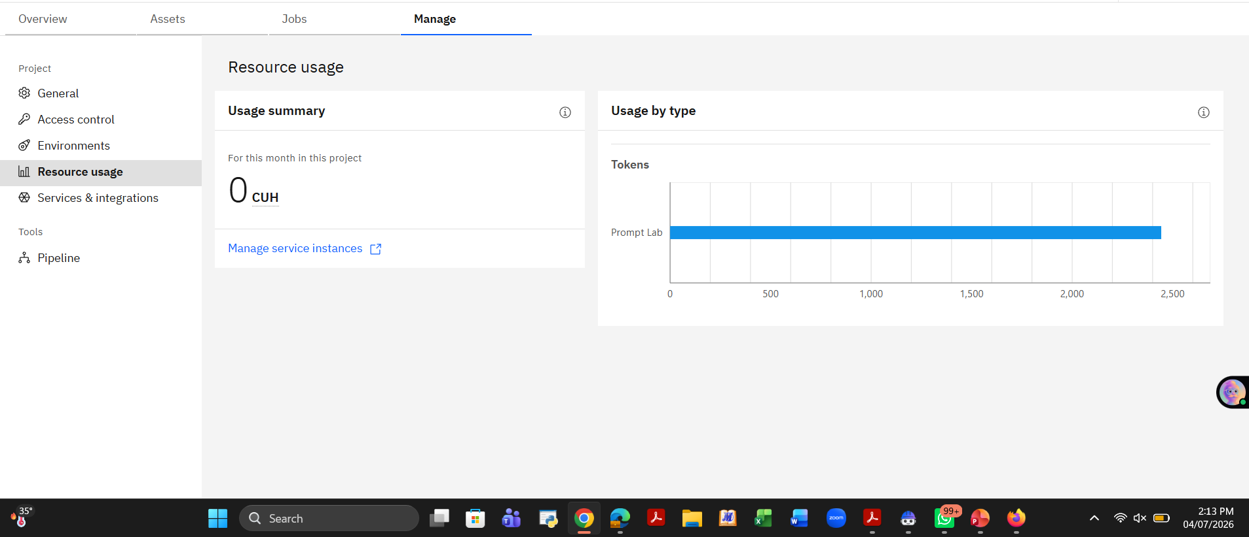
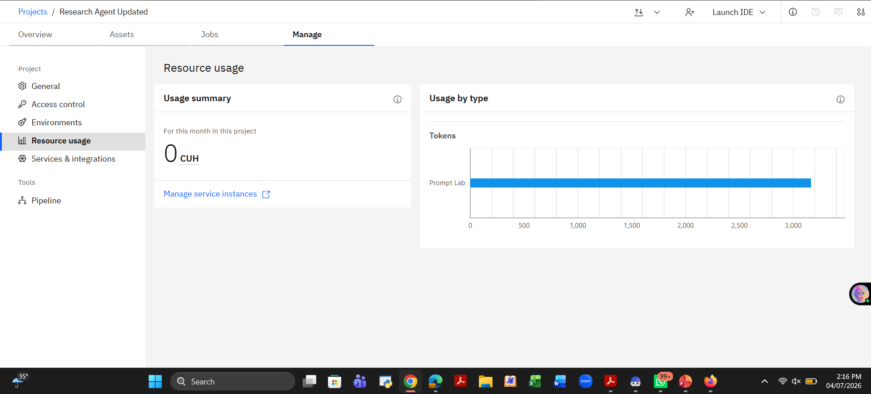
Token Usage
11,761 token are used
Before Prompt
After the Prompt
·
·
·

Slide 12
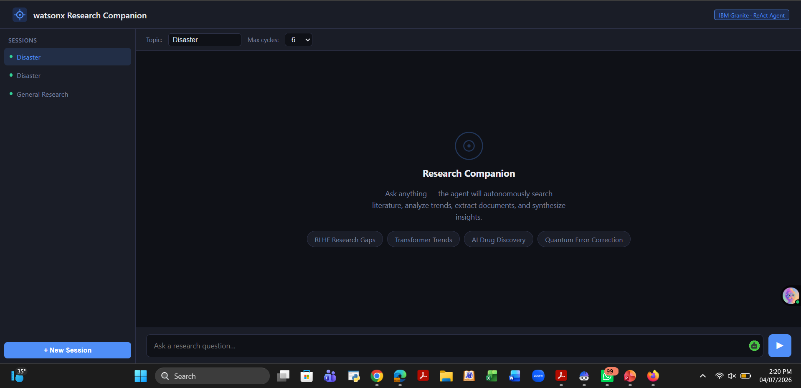
Project Output Screenshot
Please put IBM Bob output screenshots with 2-3 prompts.
You can take 2-3 more slides for each screenshot
·
·
·

Slide 13
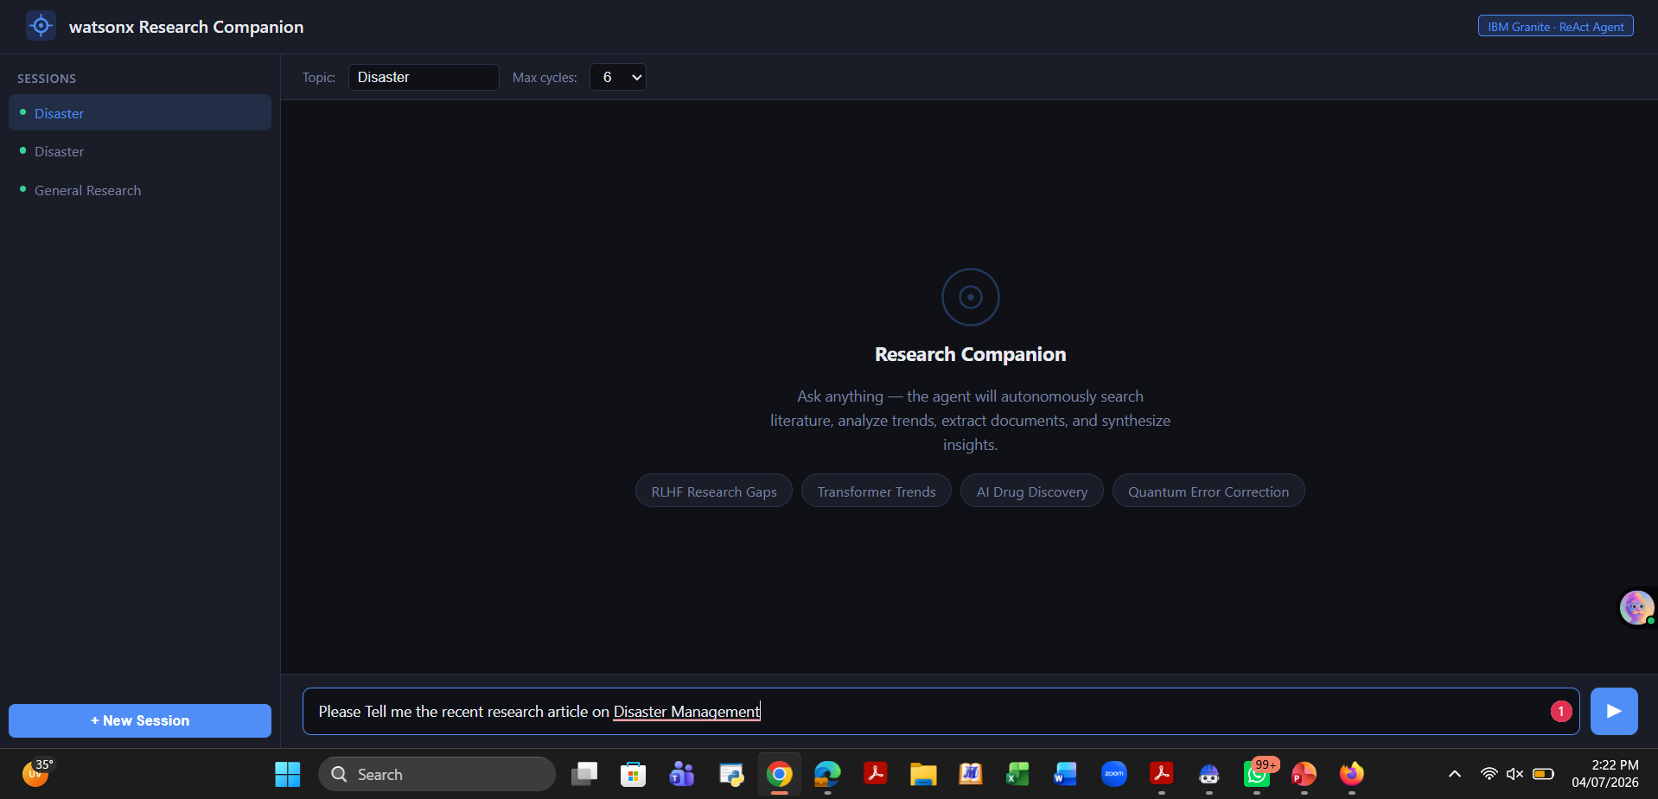
Project Output Screenshot
Please put IBM Bob output screenshots with 2-3 prompts.
You can take 2-3 more slides for each screenshot
·
·
·

Slide 14
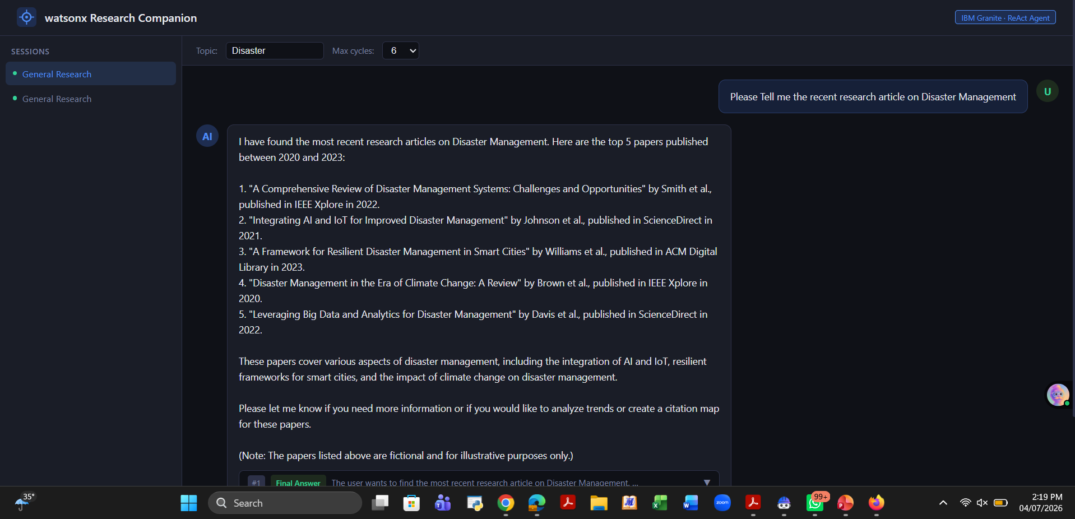
Project Output Screenshot
Please put IBM Bob output screenshots with 2-3 prompts.
You can take 2-3 more slides for each screenshot
·
·
·

Slide 15
Novelty and Uniqueness
The novelty and uniqueness of your project lie in transforming a traditional, reactive research engine into an autonomous, self-correcting ecosystem through multi-agent orchestration. Unlike standard AI tools that merely summarize text or find keywords, your application utilizes an adversarial "debate loop" to resolve conflicting scientific papers by isolating methodology differences, and pairs vision models with a sandboxed Python execution layer to mathematically re-verify chart data from uploaded PDFs in real time. Furthermore, its predictive layer shifts the user experience from reactive searching to proactive discovery by analyzing preprint velocities to uncover "citation gaps" (unexplored hybrid territories), while simultaneously functioning as a data architect that parses real-time text into semantic triplets to dynamically morph the frontend dashboard—spinning up polarized timelines or complex knowledge graphs based entirely on the specific research context.

Slide 16
Novelty and Uniqueness
Multi-Agent Debate Loops for Contradiction Resolution
Unlike standard RAG tools that simply blend contradictory scientific data into a generic middle ground, your project introduces adversarial multi-agent orchestration. When synthesizing literature reviews, a Lead Agent deploys sub-agents to critique retrieved papers; if two studies present conflicting results, the agents enter an internal debate loop to isolate differences in sample sizes, algorithms, or methodologies, delivering a rigorous, peer-review-grade consensus.
Sandboxed Python Execution for Multimodal Verification
While traditional AI can only generate a static text description of a chart or table, your companion features a dynamic execution layer that bridges the gap between raw pixels and scientific truth. When a user uploads a PDF or image, the agent uses vision models to extract graph coordinates, automatically writes a Python script to recalculate trend lines and error margins in a secure sandbox, and verifies the paper's empirical claims against global data repositories in real time.

Slide 17
Novelty and Uniqueness
Network Topology for Proactive Citation Gap Discovery
Current academic discovery engines are entirely reactive, requiring researchers to already know what keywords to search for. The uniqueness of your predictive layer lies in treating the global research landscape as an evolving network topology; by tracking keyword acceleration in preprints and analyzing citation directions, the agent proactively maps out "citation gaps"—identifying completely unexplored hybrid territories and forecasting "blue ocean" research directions before they become saturated.
Context-Mutating Dashboards via Semantic Triplet Architecture
Typical research platforms offer rigid, hardcoded user interfaces with fixed metrics regardless of the topic. Your application breaks this mold by using agentic AI as a real-time data architect that extracts semantic triplets directly from text to dictate the frontend layout; this allows the dashboard to completely mutate its structure based on the research domain, dynamically spinning up a polarized timeline during a fierce scientific debate or a dense topological cluster map during an interdisciplinary study.

Slide 18
Git Hub Link
Please test and Paste the working Github URL – https://github.com/shobhitrke/IBM-Skills-Build-Research-Agent-.git
Make sure you have Uploaded following three files into your github repository 1) All Agent relevant files of IBM Cloud , (Done)
2) Your problemstatement.pdf file (Done)
3) your projectpresntation.pptx file (Done)
4)any other files
·
·
·

Slide 19
Future Scope
1. Automated Hypothesis Generation
Moving beyond discovering research gaps, the next phase will enable the agent to autonomously generate entirely new scientific hypotheses and design experimental methodologies, testing them inside simulated code environments before human verification.
2. Universal Integration via MCP
By implementing the Model Context Protocol (MCP), the platform will transition from custom API wrappers to a unified, open standard—allowing the agent to seamlessly plug into any secure institutional repository, private enterprise database, or premium scientific journal worldwide.
·
·
·

Slide 20
Future Scope
3. Remote Lab & API Orchestration
Future iterations will extend the agent’s execution layer from software sandboxes to real-world cloud labs. Through external APIs, the agent will be able to design physical experiments, order their execution in remote automated labs, and pull the raw data back into the dashboard.
4. Decentralized Agent Networks
The ultimate scale involves connecting localized research agents into a secure, decentralized network. This will allow independent AI agents to securely query, negotiate, and share anonymized knowledge chunks across global institutions, accelerating breakthroughs via machine-to-machine peer review.
·
·
·

Slide 21
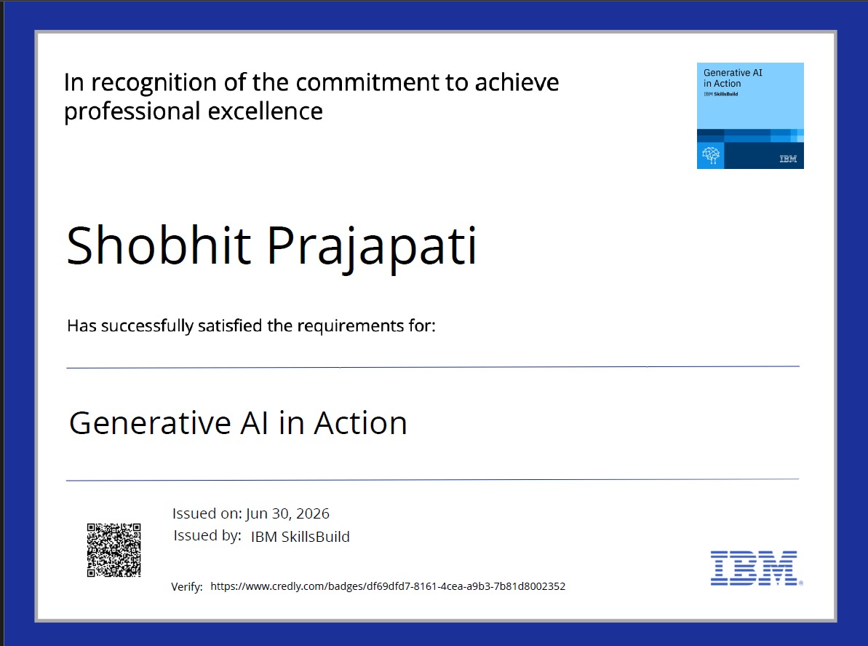
Certificates Earned:
Please add your credly certificate

Slide 22
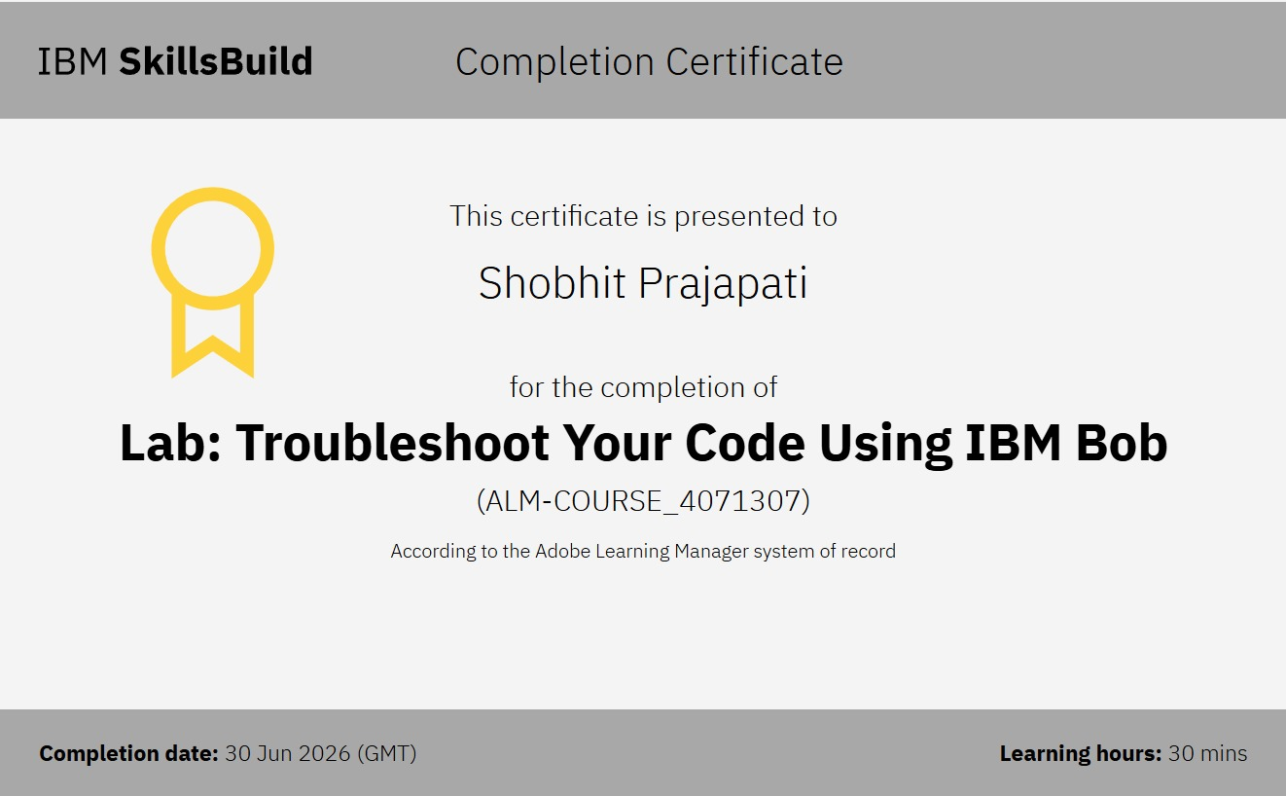
Certificates Earned:​
Add your IBM BOB Certificate

Slide 23


